Slide 1
Convolution Neural Network (CNN)

Slide 2
AGENDA
Introduction
Convolution Neural Network
Successful CNN Architectures
CNN Model Training
Transfer Learning
Demo - Image Classifier

Slide 3


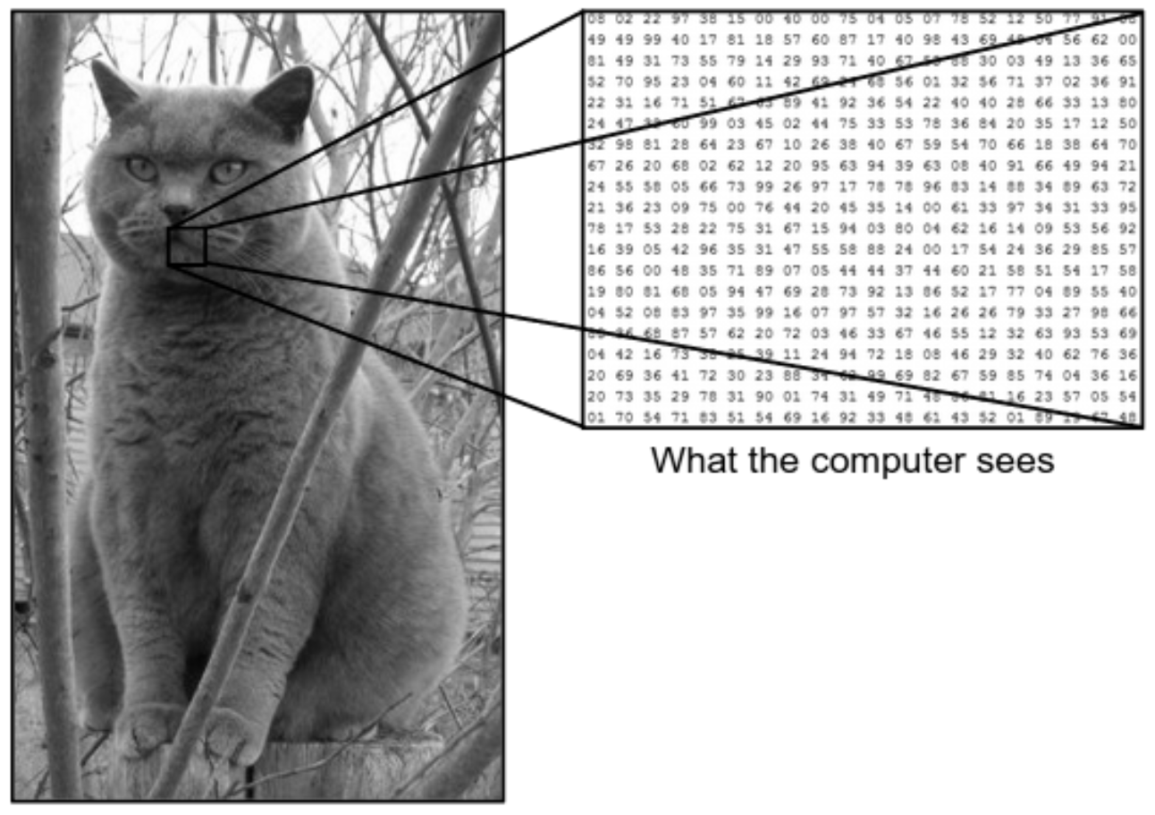
Introduction
Computer Vision is one of the hottest research fields within Deep Learning at the moment which sits at the intersection of many academic subjects, such as Computer Science , Mathematics, Engineering, Physics, Biology, and Psychology
Recent advancements in Computer Vision with Deep Learning are Image Classification, Object Detection, Object Tracking, etc..,
Image classification is the task of taking an input image and outputting a class or a probability of classes that best describes the image
For humans, this task is one of the first skills we learn and it comes naturally and effortlessly as adults and able to quickly recognize patterns, generalize from prior knowledge, and adapt to different image environments are difficult tasks for machines
What we see vs. What computers see---------------------------------

Slide 4
Convolution Neural Network (CNN)
Convolution Neural Network (CNN) or ConvNets is a Deep Learning algorithm
which can take in an input image,
assign importance (learnable weights and biases) to various aspects/objects in the image, and
will be able to differentiate one from the other
A simple ConvNet is a sequence of layers, and every layer of a ConvNet transforms one volume of activations to another through a differentiable function
Three main types of layers to build ConvNet architectures:
Convolutional Layer (Conv + Activation)
Pooling Layer
Fully-Connected Layer
Notes:
https://medium.com/swlh/introduction-to-cnn-image-classification-using-cnn-in-pytorch-11eefae6d83c
https://towardsdatascience.com/simple-introduction-to-convolutional-neural-networks-cdf8d3077bac
https://medium.com/technologymadeeasy/the-best-explanation-of-convolutional-neural-networks-on-the-internet-fbb8b1ad5df8
https://purnasaigudikandula.medium.com/a-beginner-intro-to-convolutional-neural-networks-684c5620c2ce
https://medium.com/@srajaninnov/an-introduction-to-convolutional-neural-networks-cnn-a6e48829ff66
https://medium.com/@RaghavPrabhu/understanding-of-convolutional-neural-network-cnn-deep-learning-99760835f148
https://medium.com/nybles/a-brief-guide-to-convolutional-neural-network-cnn-642f47e88ed4
Transfer Learning
https://medium.com/@rinu.gour123/transfer-learning-for-deep-learning-with-cnn-afa1fe0aa7e2
https://machinelearningmastery.com/transfer-learning-for-deep-learning/
https://machinelearningmastery.com/how-to-use-transfer-learning-when-developing-convolutional-neural-network-models/
https://towardsdatascience.com/a-comprehensive-hands-on-guide-to-transfer-learning-with-real-world-applications-in-deep-learning-212bf3b2f27a
https://towardsdatascience.com/cnn-transfer-learning-fine-tuning-9f3e7c5806b2
https://towardsdatascience.com/transfer-learning-with-convolutional-neural-networks-in-pytorch-dd09190245ce

Slide 5

Fig. Generic End-to-End Architecture of a CNN Classifier

Slide 6

1. CONVOLUTION LAYER
uses filters (Kernel) that perform convolution operations as it is scanning through the input image with respect to its dimensions.
Its hyperparameters include the filter size and stride . The resulting output is called feature map or activation map.
Since Convolution is a linear operation and images are far from linear, non-linearity is (Activation Functions) introduced directly after the convolutional layer to introduce non-linearity to the activation map.
There are several types of non-linear operations (Activation Functions) and few are :
Sigmoid
Tanh
Relu

Slide 7


Fig. Basic Convolution Operation
Fig. Convolution operation on a MxNx3 image matrix with a 3x3x3 Kernel

Slide 8
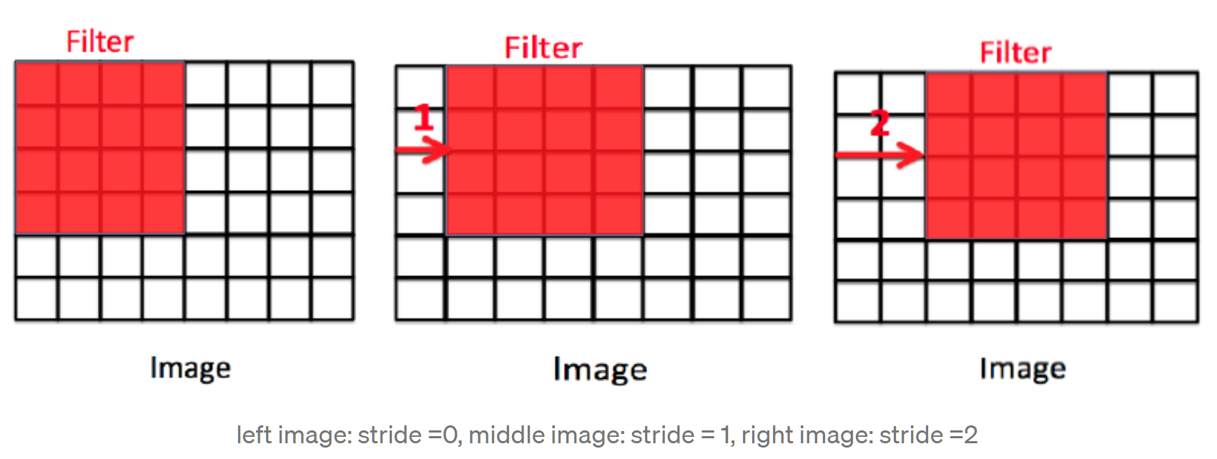
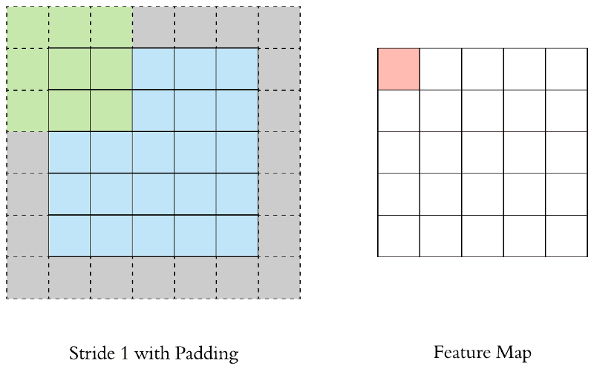
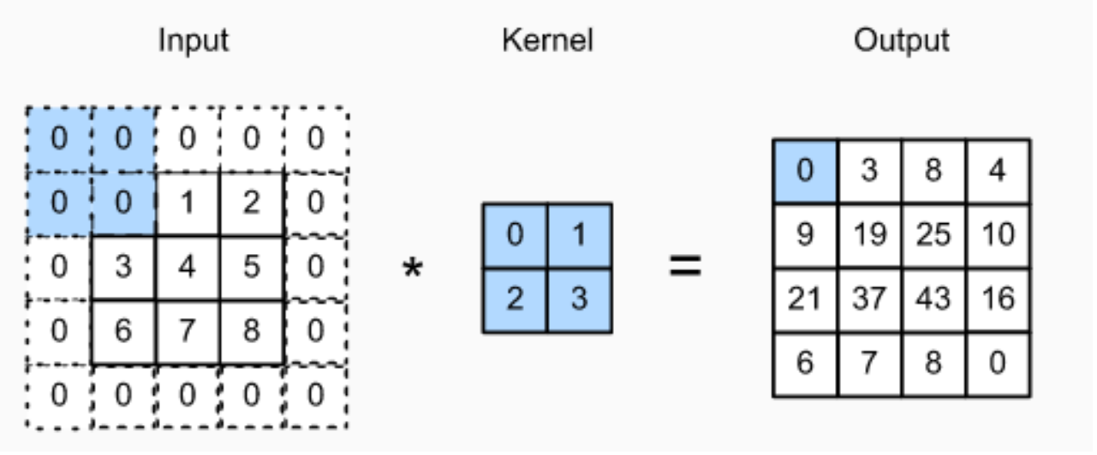
Stride - For a convolutional or a pooling operation, the stride denotes the number of pixels by which the window moves after each operation.
Padding - One tricky issue when applying convolutional layers is that we tend to lose pixels on the perimeter of our image. Since we typically use small kernels, for any given convolution, we might only lose a few pixels, but this can add up as we apply many successive convolutional layers. One straightforward solution to this problem is to add extra pixels of filler around the boundary of our input image, thus increasing the effective size of the image. Few types of padding are Same Padding / Zero Padding, Casual Padding, etc

Slide 9
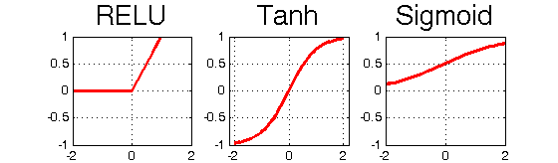
Activation Functions
Activation functions are a critical part of the design of a neural network.
The choice of activation function in the hidden layer will control how well the network model learns the training dataset.
The choice of activation function in the output layer will define the type of predictions the model can make.
As such, a careful choice of activation function must be made for each deep learning neural network project.
There are several types of non-linear operations (Activation Functions) available for hidden layers and few of them are :
Sigmoid - between 0 to 1
Tanh - between -1 to 1
Relu - max(0.0, x) (widely used)

Slide 10
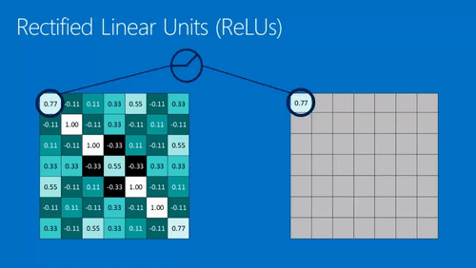
Fig. Relu Activation --- max(0,x)

Slide 11
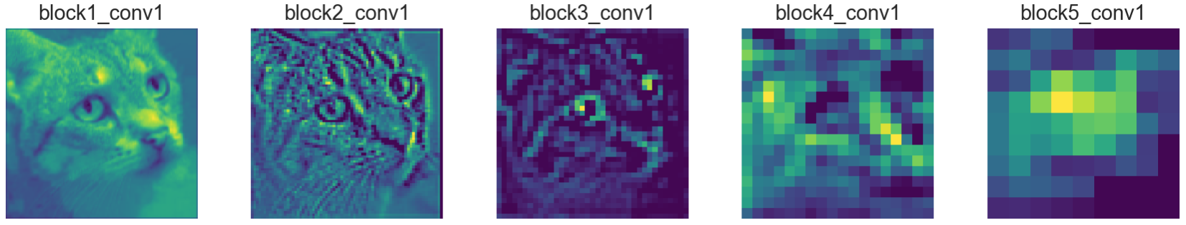
Fig. Result of Convolution is a Feature Map

Slide 12
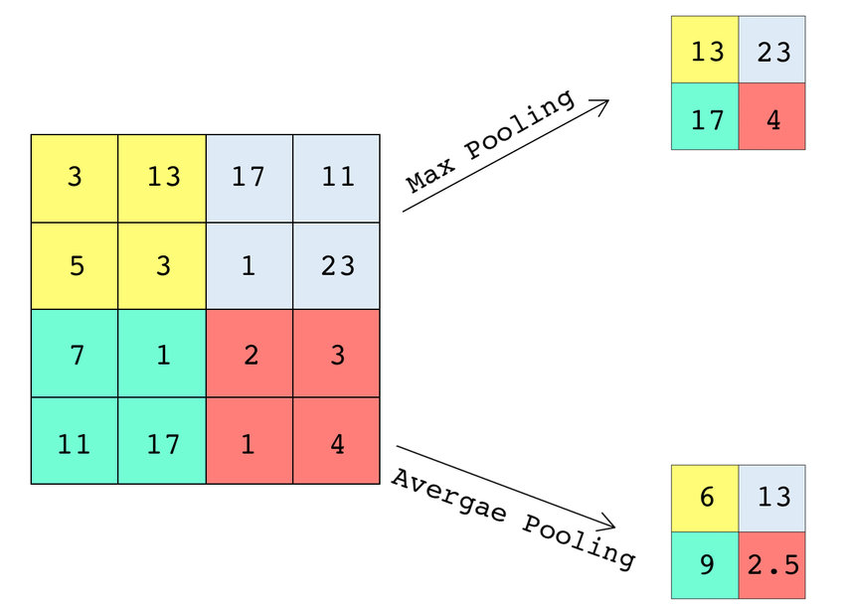
2. POOLING LAYER
is a down sampling operation, typically applied after a convolution layer
down samples the image in its height and width but the number of channels(depth) stays the same
In particular, max and average pooling are special kinds of pooling where the maximum and average value is taken, respectively.
Two Types : 1. Average Pooling 2. Max Pooling

Slide 13
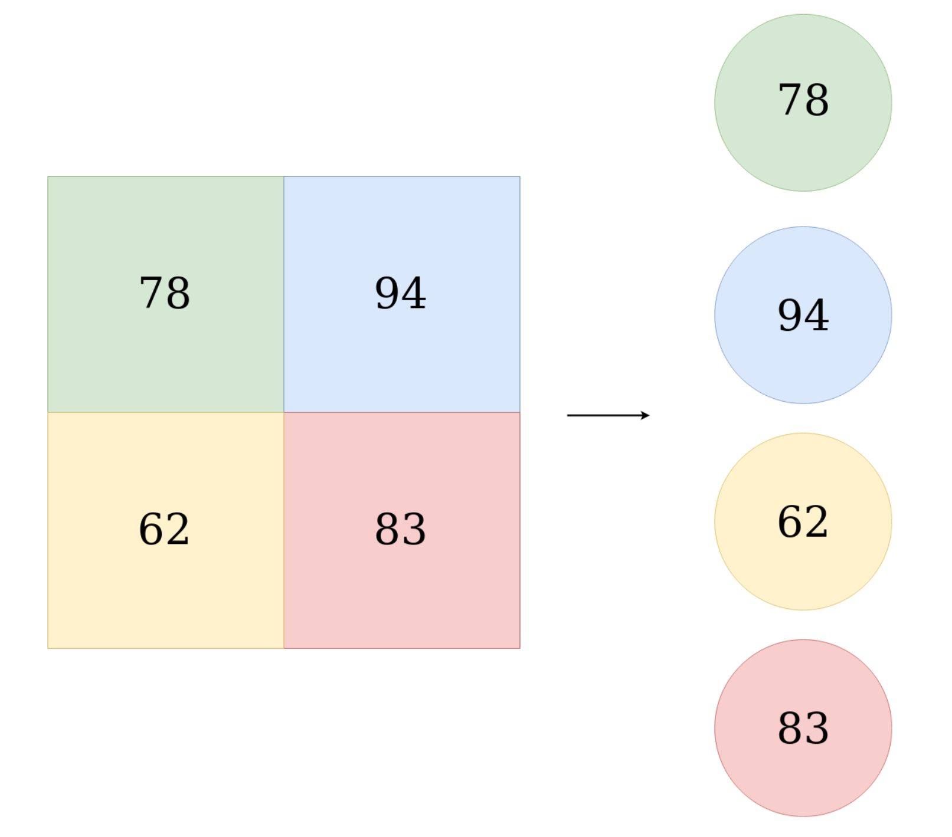
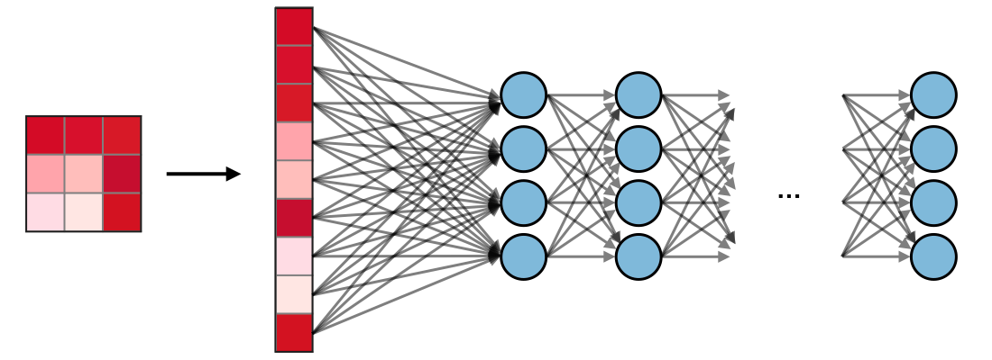
3. FULLY CONNECTED (FC) LAYER
is simply a feed forward neural networks that form the last few layers in the network, used to optimize objectives such as class scores.
input to the fully connected layer is the output from the final Pooling or Convolutional Layer, which is flattened and then fed into the fully connected layer.
Here in FC to reduce overfitting Dropouts can also be used and sometime Batch Normalization is also used.
Fig. Flattening

Slide 14
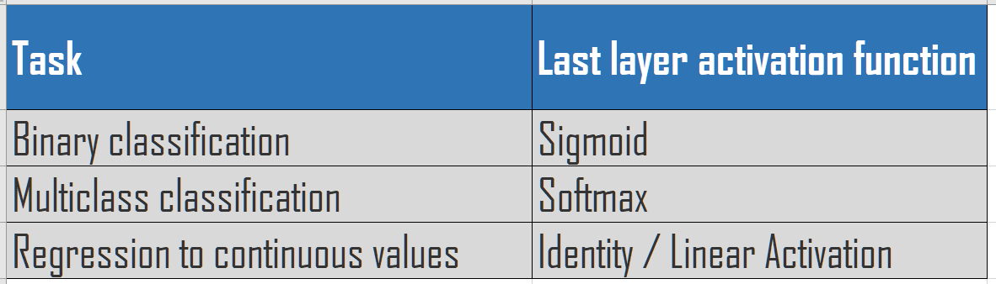
Last Layer Activation Function / Softmax Layer / Classification layer
An activation function is applied to the last fully connected layer which is usually different from the others
Appropriate activation function needs to be selected according to each task.
the activation function applied to the multiclass classification task is a softmax function which normalizes output real values from the last fully connected layer to target class probabilities, where each value ranges between 0 and 1 and all values sum to 1.

Slide 15
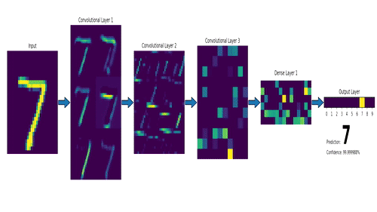
Fig. CNN Classifier

Slide 16
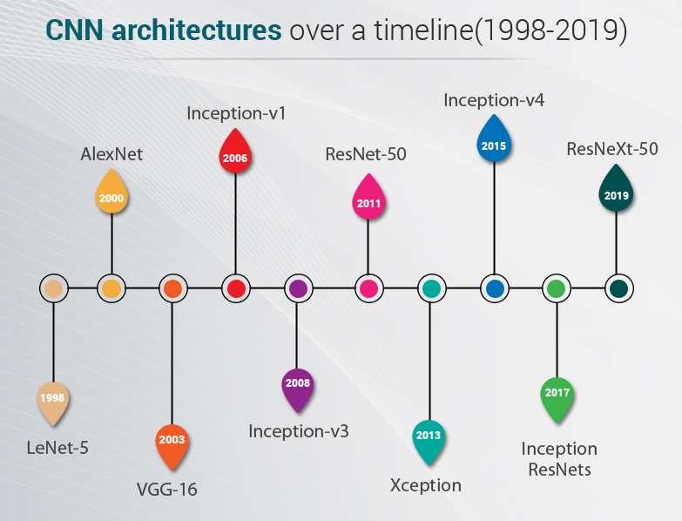
Successful CNN Architectures

Slide 17
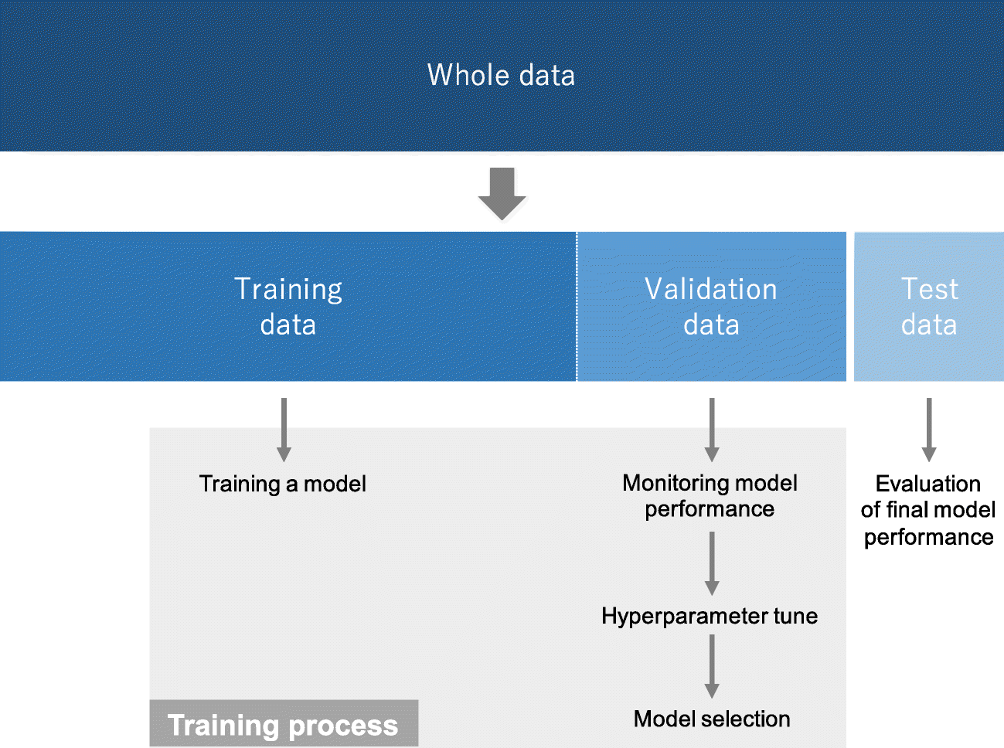
CNN Model Training
Notes:
https://insightsimaging.springeropen.com/articles/10.1007/s13244-018-0639-9/figures/8

Slide 18
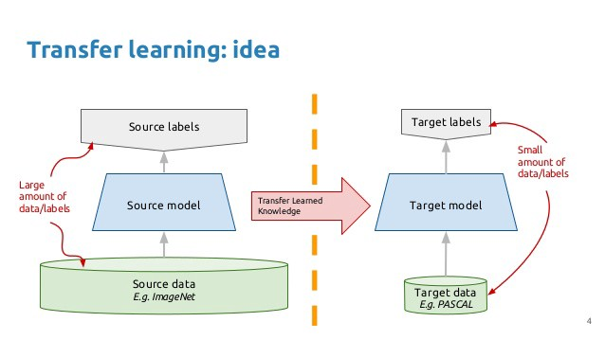
Transfer Learning
Transfer learning is the most popular approach in deep learning, where we use pre-trained models as the starting point in computer vision.
To solve a problem, we need to have a pre-trained model of a similar problem. Instead of building a model from scratch to solve a similar problem, we use the model trained on other problem as a starting point.
While choosing a pre-trained model, one should be careful in their case. If the problem statement we have at hand is very different from the one on which the pre-trained model was trained — the prediction we would get would be very inaccurate.
Following is the general outline for transfer learning for object recognition:
Load in a pre-trained CNN model trained on a large dataset
Freeze parameters (weights) in model’s lower convolutional layers
Add custom classifier with several layers of trainable parameters to model
Train classifier layers on training data available for task
Fine-tune hyperparameters and unfreeze more layers as needed

Slide 19


Slide 20


